Slide 1
Chapter 12
Enhanced Entity-Relationship Modeling
Transparencies

Slide 2
Chapter 12 - Objectives
Limitations of basic concepts of the ER model and requirements to represent more complex applications using additional data modeling concepts.
Most useful additional data modeling concepts of Enhanced ER (EER) model called:
  specialization/generalization;
  aggregation;
  composition.

Slide 3
Chapter 12 - Objectives
A diagrammatic technique for displaying specialization/generalization, aggregation, and composition in an EER diagram using UML.

Slide 4
Enhanced Entity-Relationship Model
Since 1980s there has been an increase in emergence of new database applications with more demanding requirements.
Basic concepts of ER modeling are not sufficient to represent requirements of newer, more complex applications.
Response is development of additional ‘semantic’ modeling concepts.

Slide 5
The Enhanced Entity-Relationship Model
Semantic concepts are incorporated into the original ER model and called the Enhanced Entity-Relationship (EER) model.
Examples of additional concepts of EER model are:
  specialization / generalization;
  aggregation;
  composition.

Slide 6
Specialization / Generalization
Superclass
  An entity type that includes one or more distinct subgroupings of its occurrences.
Subclass
  A distinct subgrouping of occurrences of an entity type.

Slide 7
Specialization / Generalization
Superclass/subclass relationship is one-to-one (1:1).
Superclass may contain overlapping or distinct subclasses.
Not all members of a superclass need be a member of a subclass.

Slide 8
Specialization / Generalization
Attribute Inheritance
  An entity in a subclass represents same ‘real world’ object as in superclass, and may possess subclass-specific attributes, as well as those associated with the superclass.

Slide 9
Specialization / Generalization
Specialization
  Process of maximizing differences between members of an entity by identifying their distinguishing characteristics.
Generalization
  Process of minimizing differences between entities by identifying their common characteristics.

Slide 10
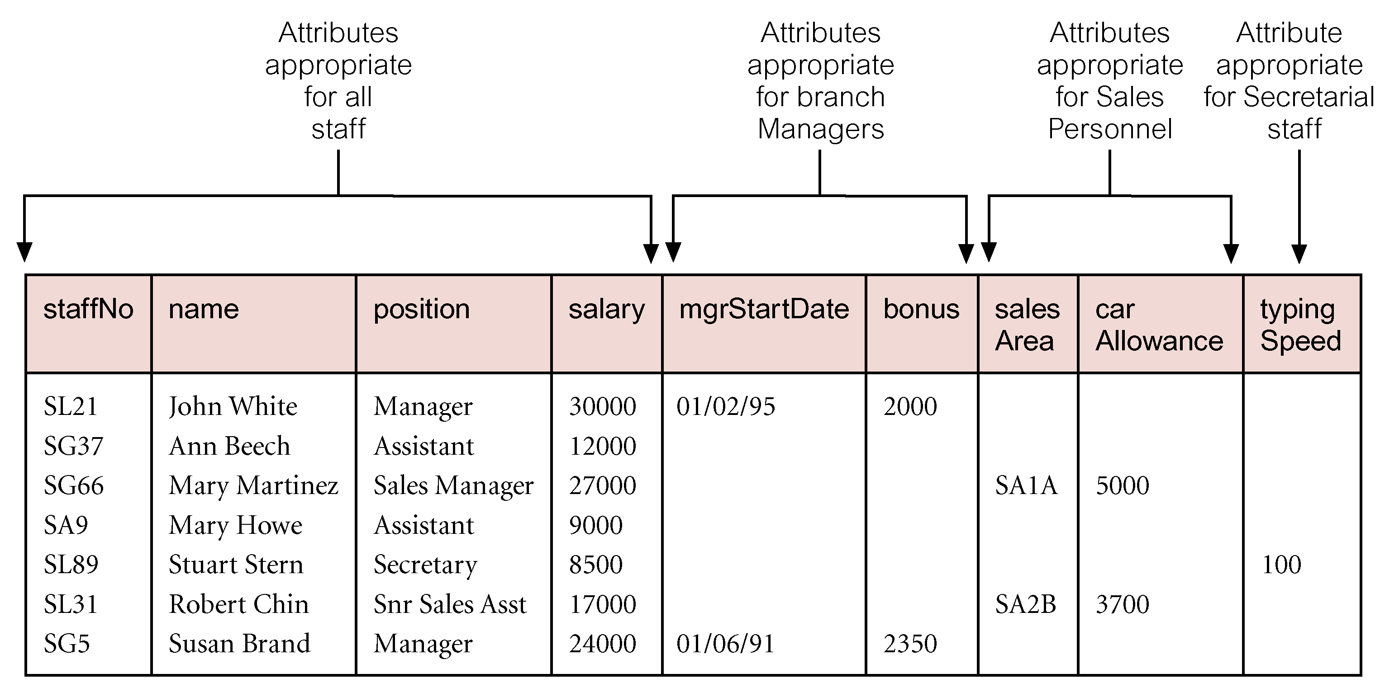
AllStaff Relation Holding Details of all Staff

Slide 11
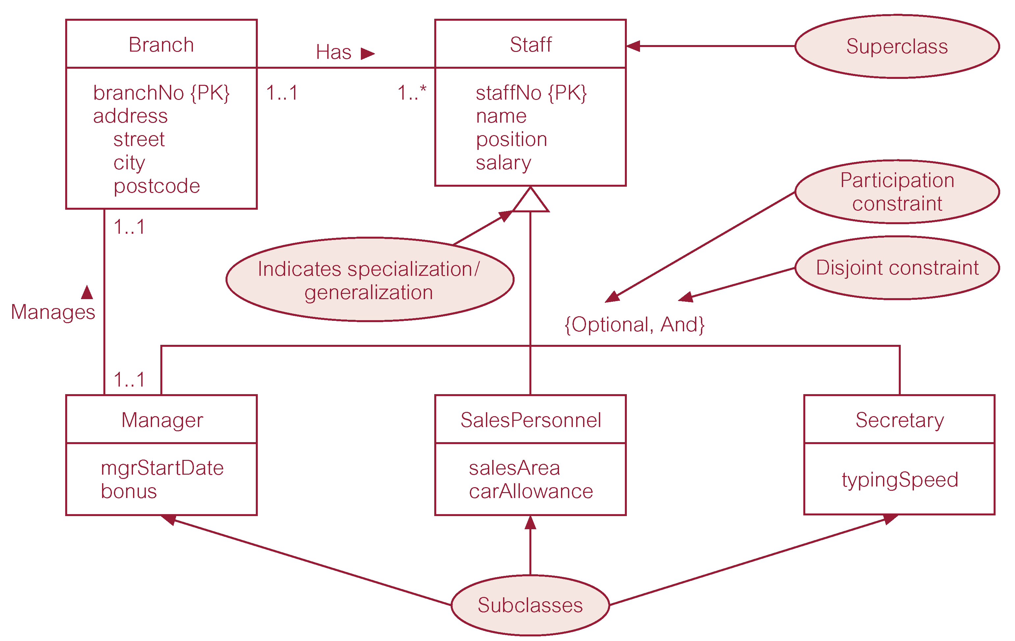
Specialization/Generalization of Staff Entity into Subclasses Representing Job Roles

Slide 12
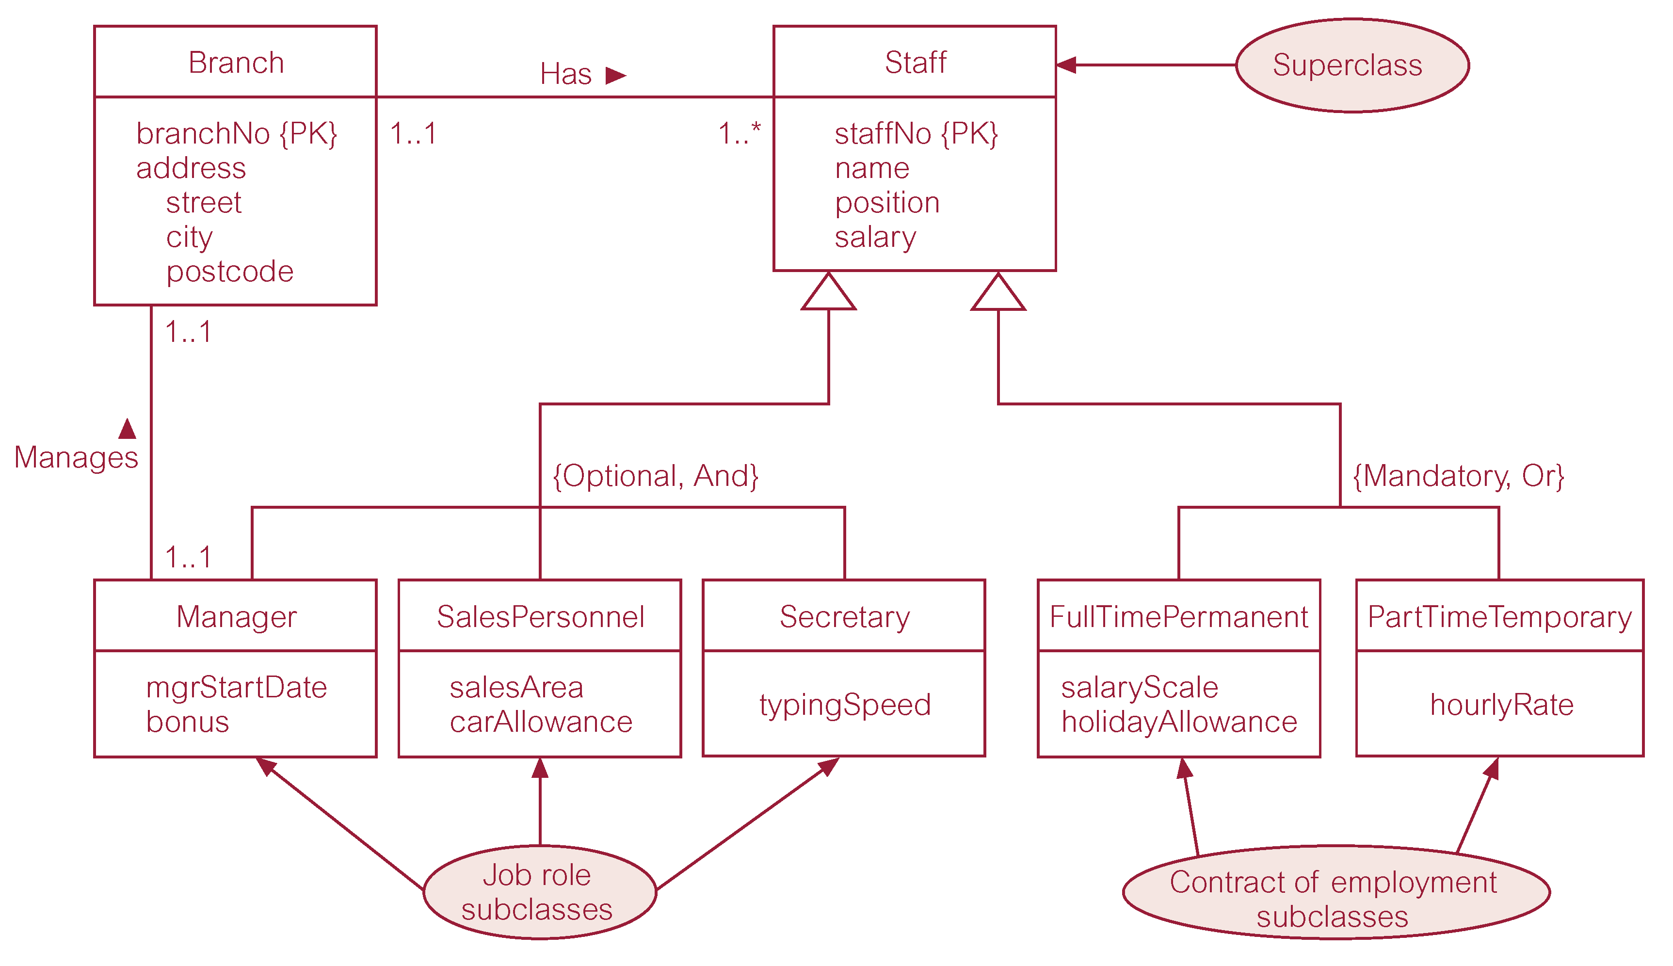
Specialization/Generalization of Staff Entity into Job Roles and Contracts of Employment

Slide 13
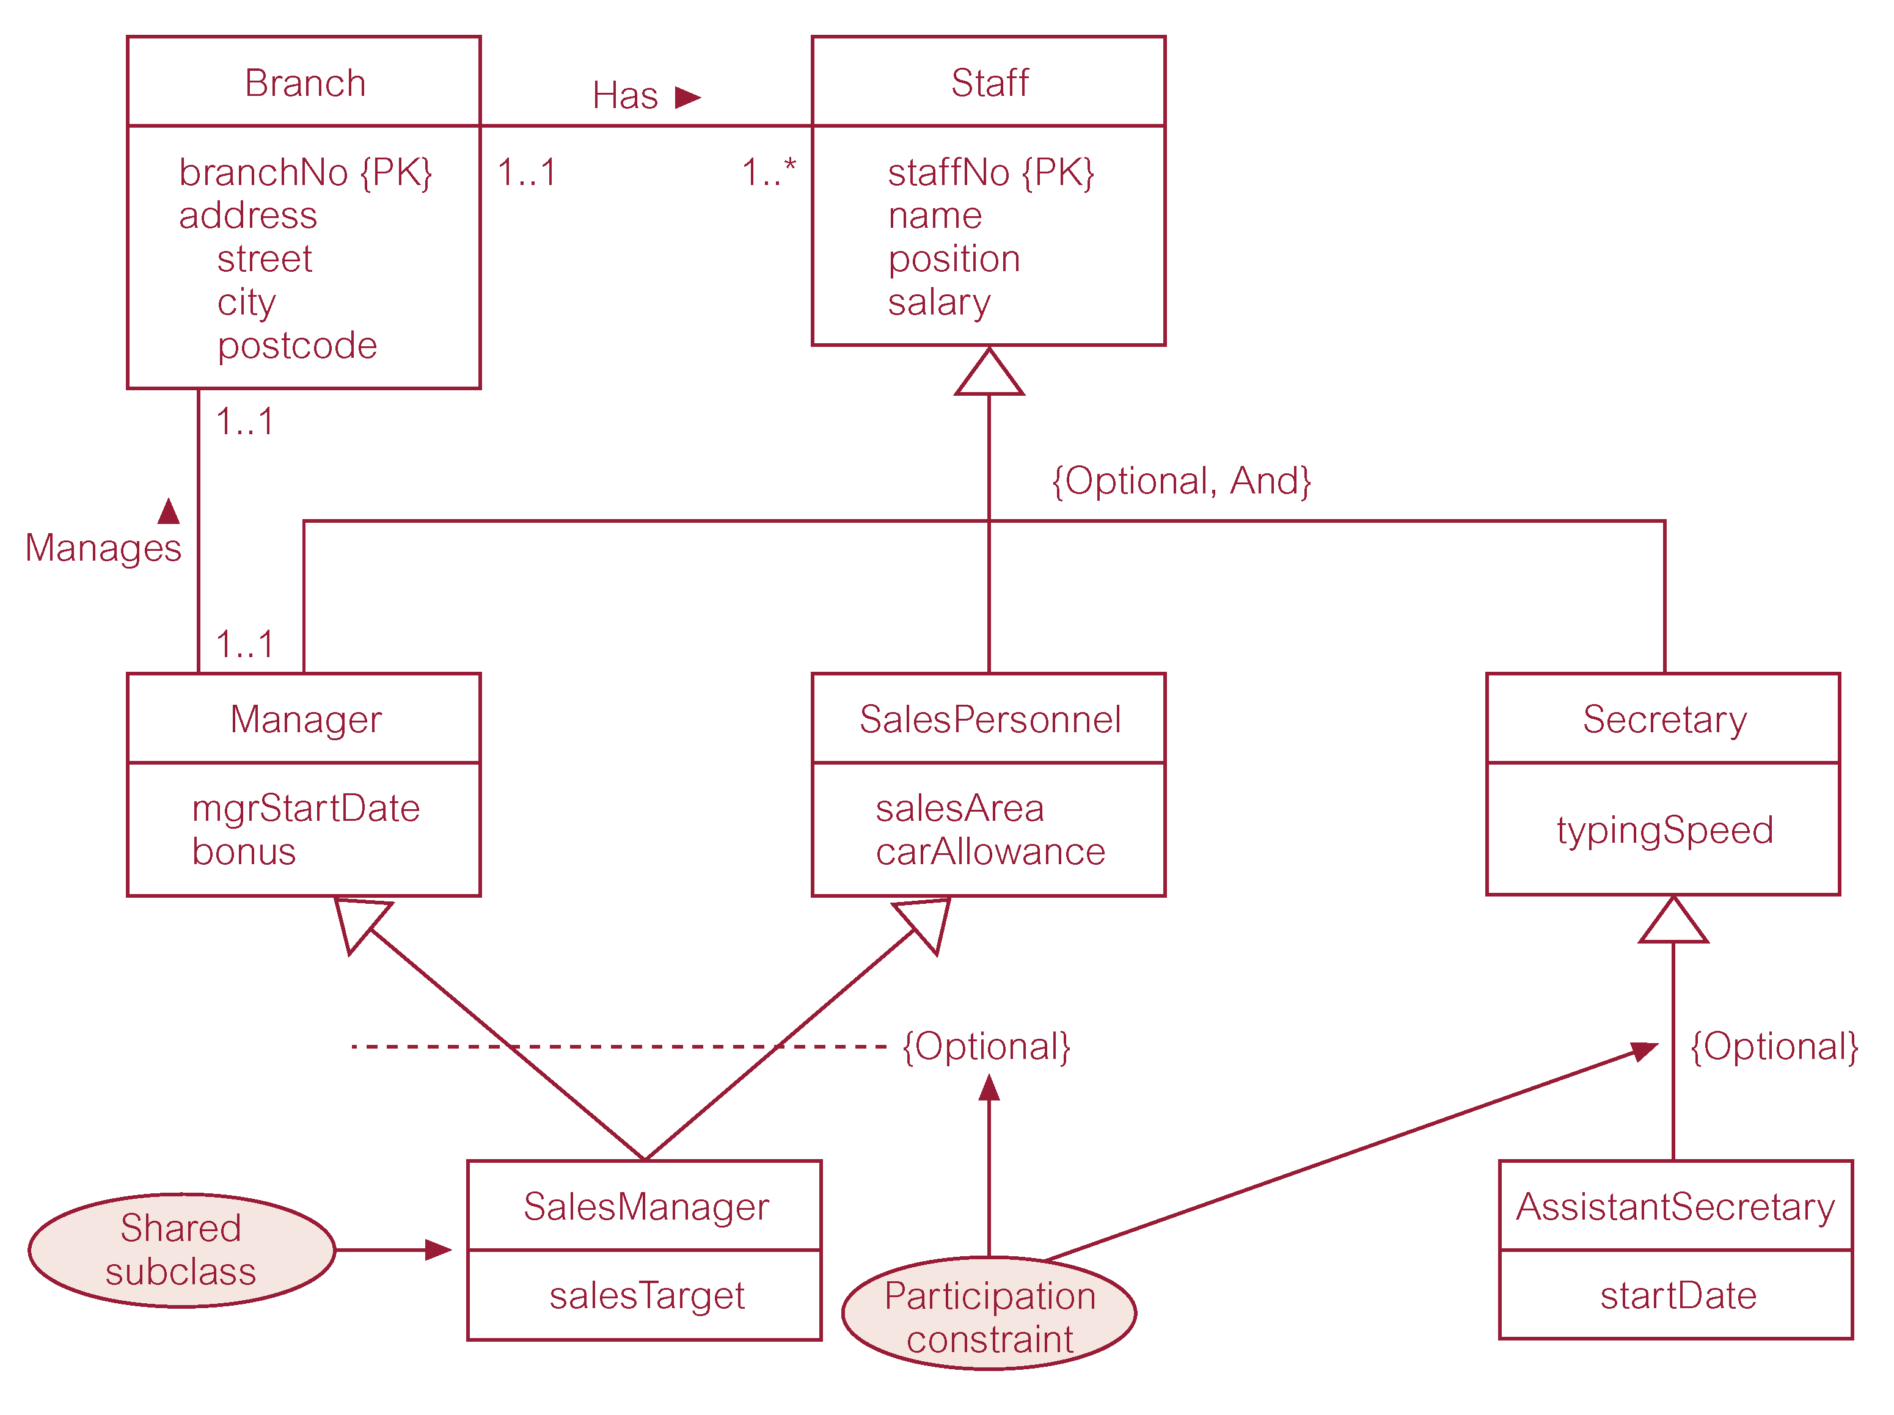
EER Diagram with Shared Subclass and Subclass with its own Subclass

Slide 14
Constraints on Specialization / Generalization
Two constraints that may apply to a specialization/generalization:
  participation constraints,
  disjoint constraints.
Participation constraint
  Determines whether every member in superclass must participate as a member of a subclass.
  May be mandatory or optional.

Slide 15
Constraints on Specialization / Generalization
Disjoint constraint
  Describes relationship between members of the subclasses and indicates whether member of a superclass can be a member of one, or more than one, subclass.
  May be disjoint or nondisjoint.

Slide 16
Constraints on Specialization / Generalization
There are four categories of constraints of specialization and generalization:
  mandatory and disjoint;
  optional and disjoint;
  mandatory and nondisjoint;
  optional and nondisjoint.

Slide 17
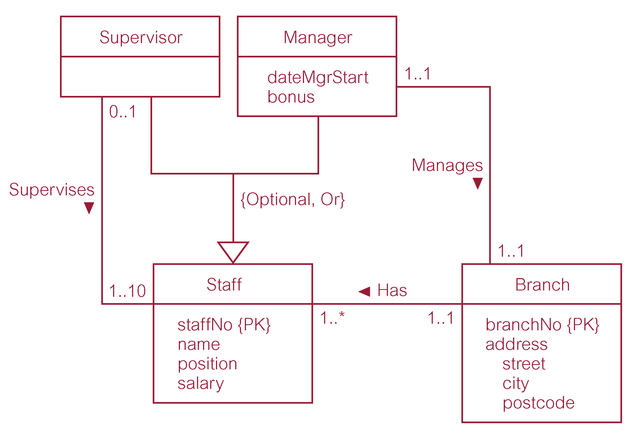
DreamHome Worked Example - Staff Superclass with Supervisor and Manager Subclasses

Slide 18
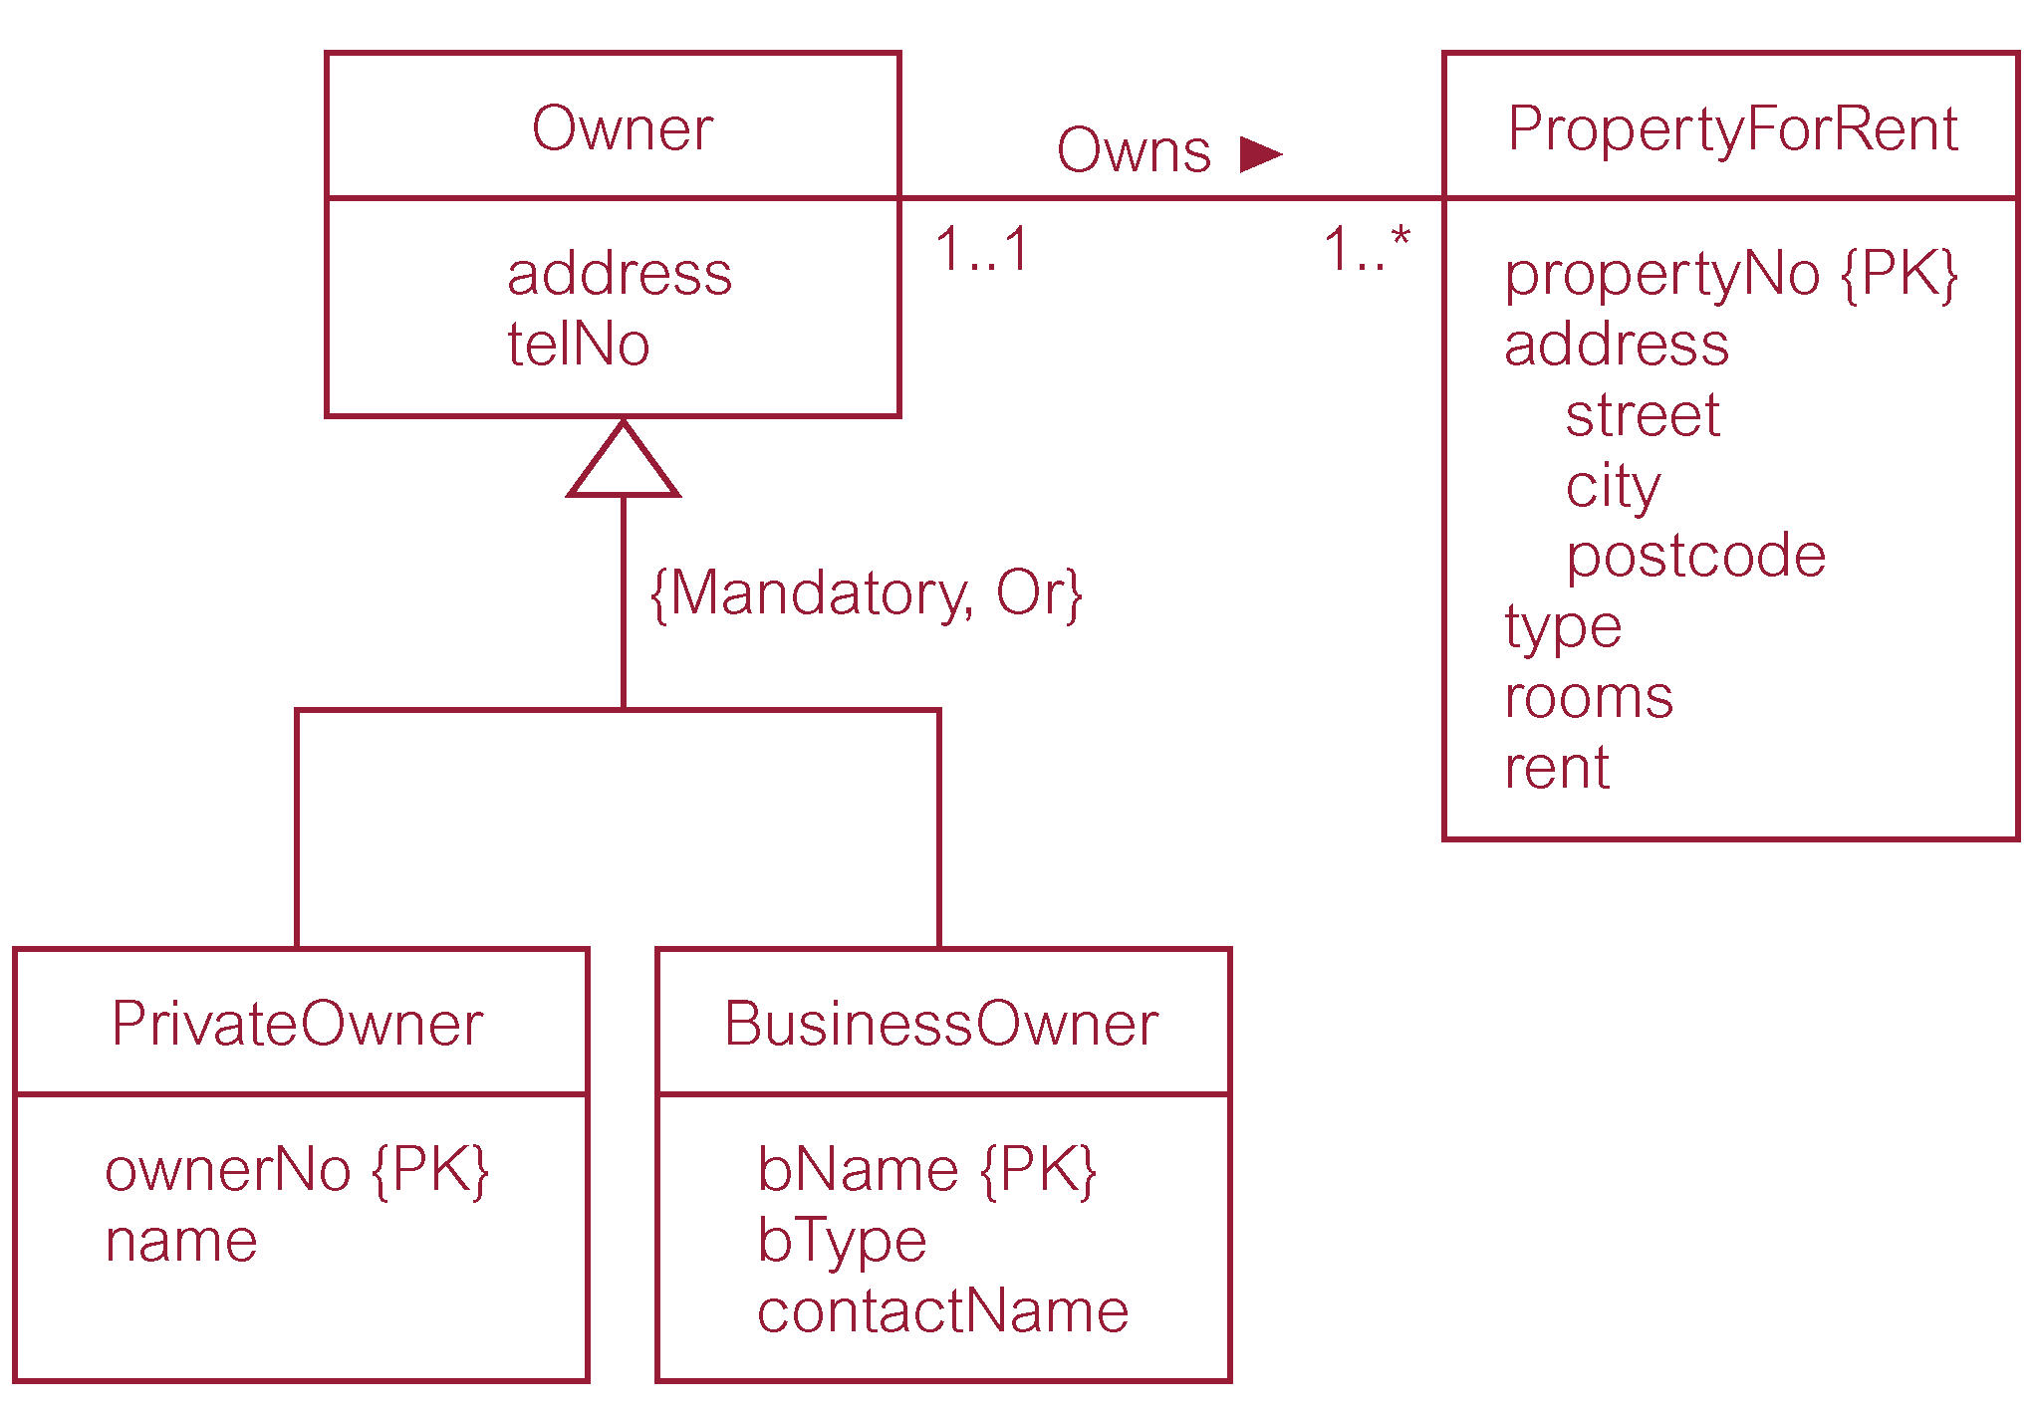
DreamHome Worked Example - Owner Superclass with PrivateOwner and BusinessOwner Subclasses

Slide 19
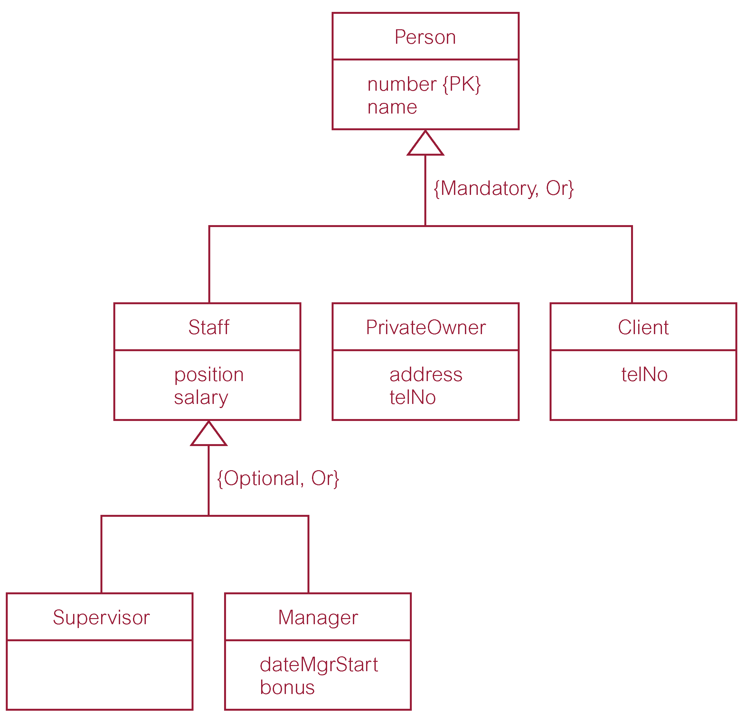
DreamHome Worked Example - Person Superclass with Staff, PrivateOwner, and Client Subclasses

Slide 20
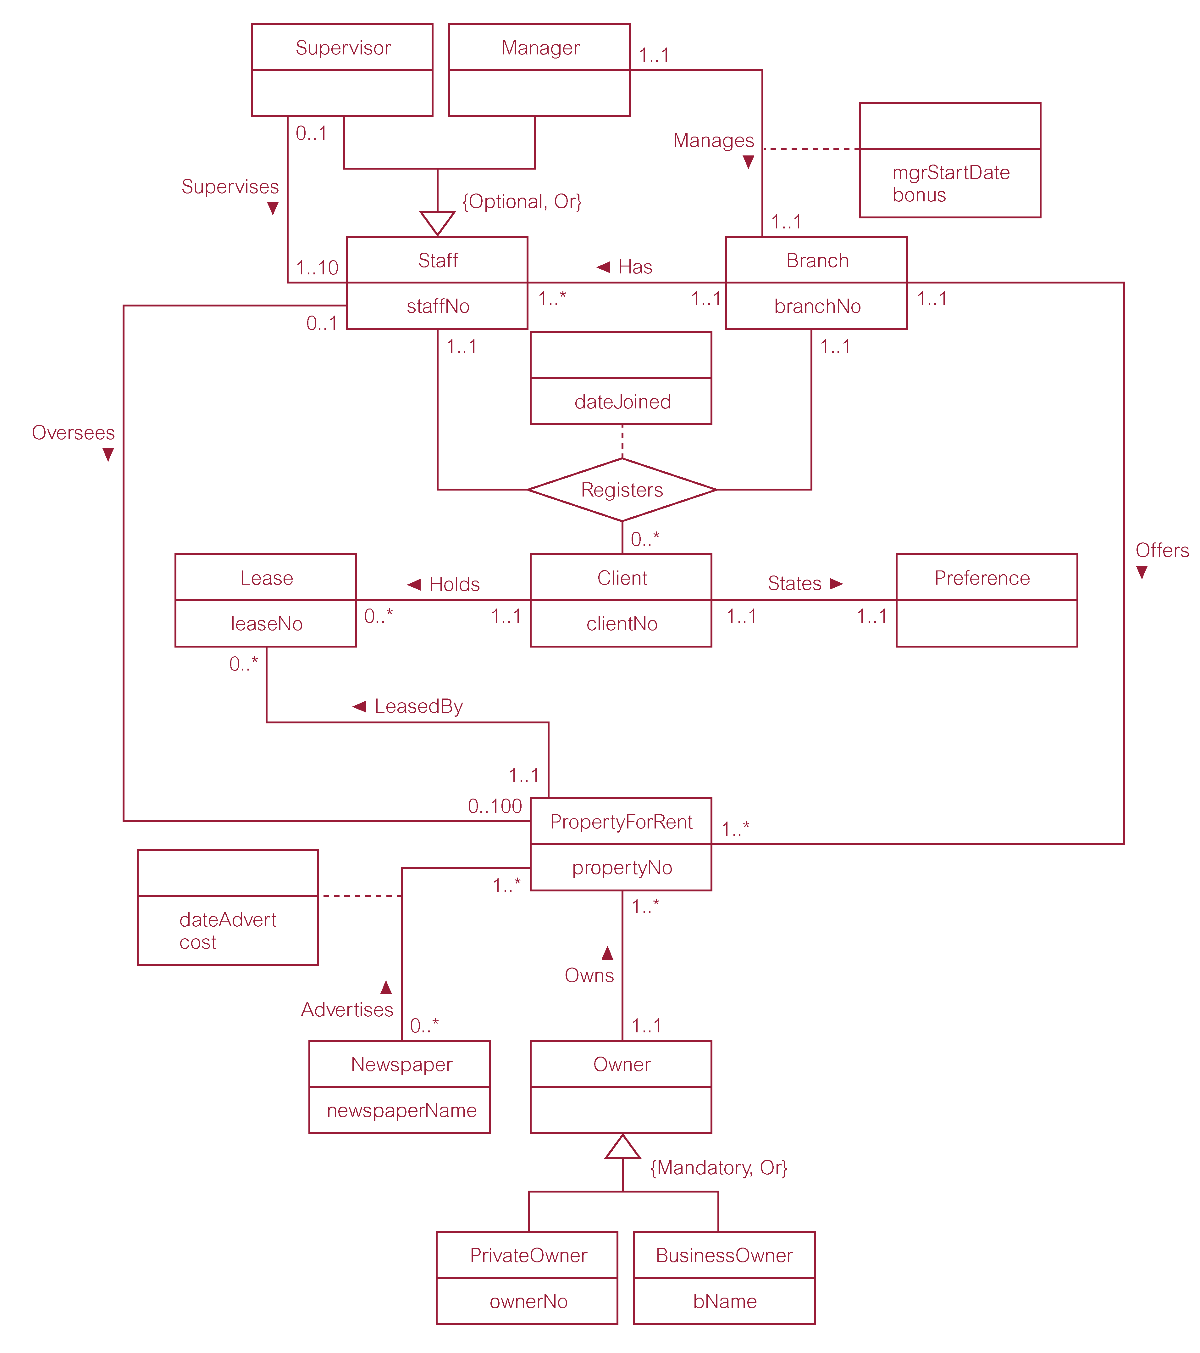
EER Diagram of Branch View of DreamHome with Specialization/Generalization

Slide 21
Aggregation
Represents a ‘has-a’ or ‘is-part-of’ relationship between entity types, where one represents the ‘whole’ and the other ‘the part’.

Slide 22
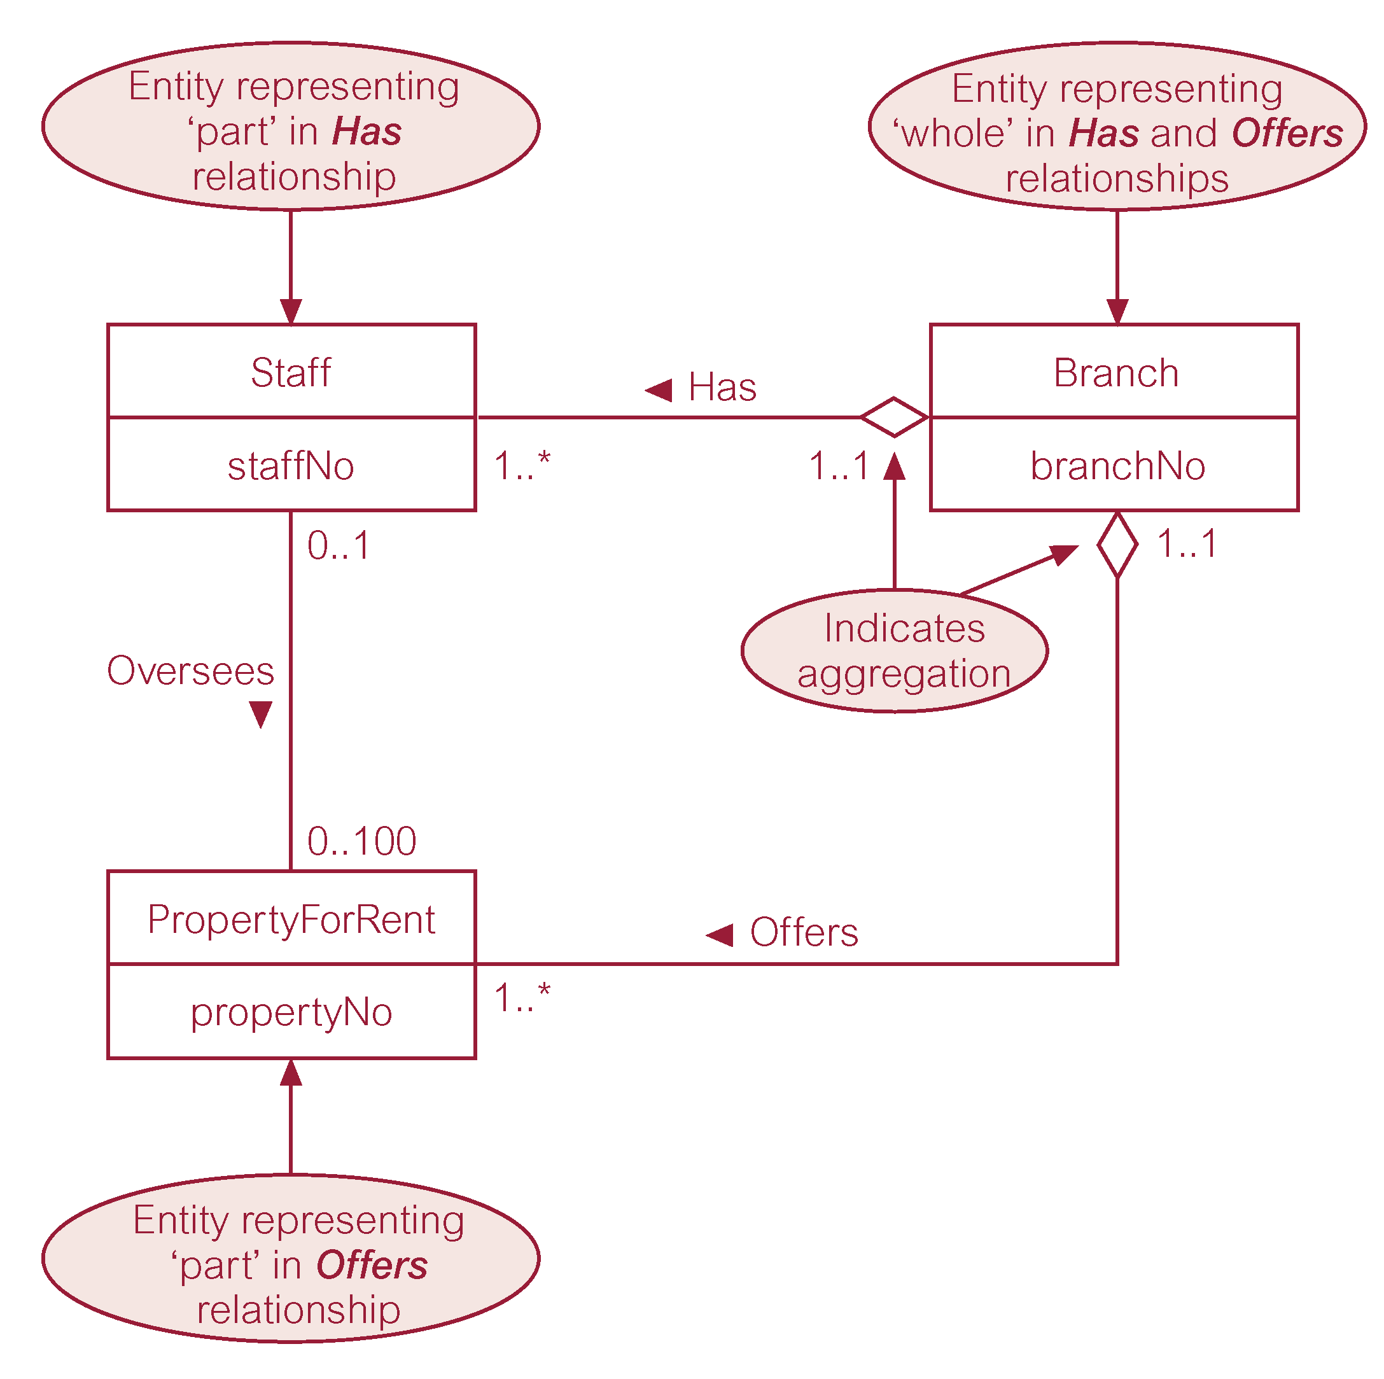
Examples of Aggregation

Slide 23
Composition
Specific form of aggregation that represents an association between entities, where there is a strong ownership and coincidental lifetime between the ‘whole’ and the ‘part’.

Slide 24
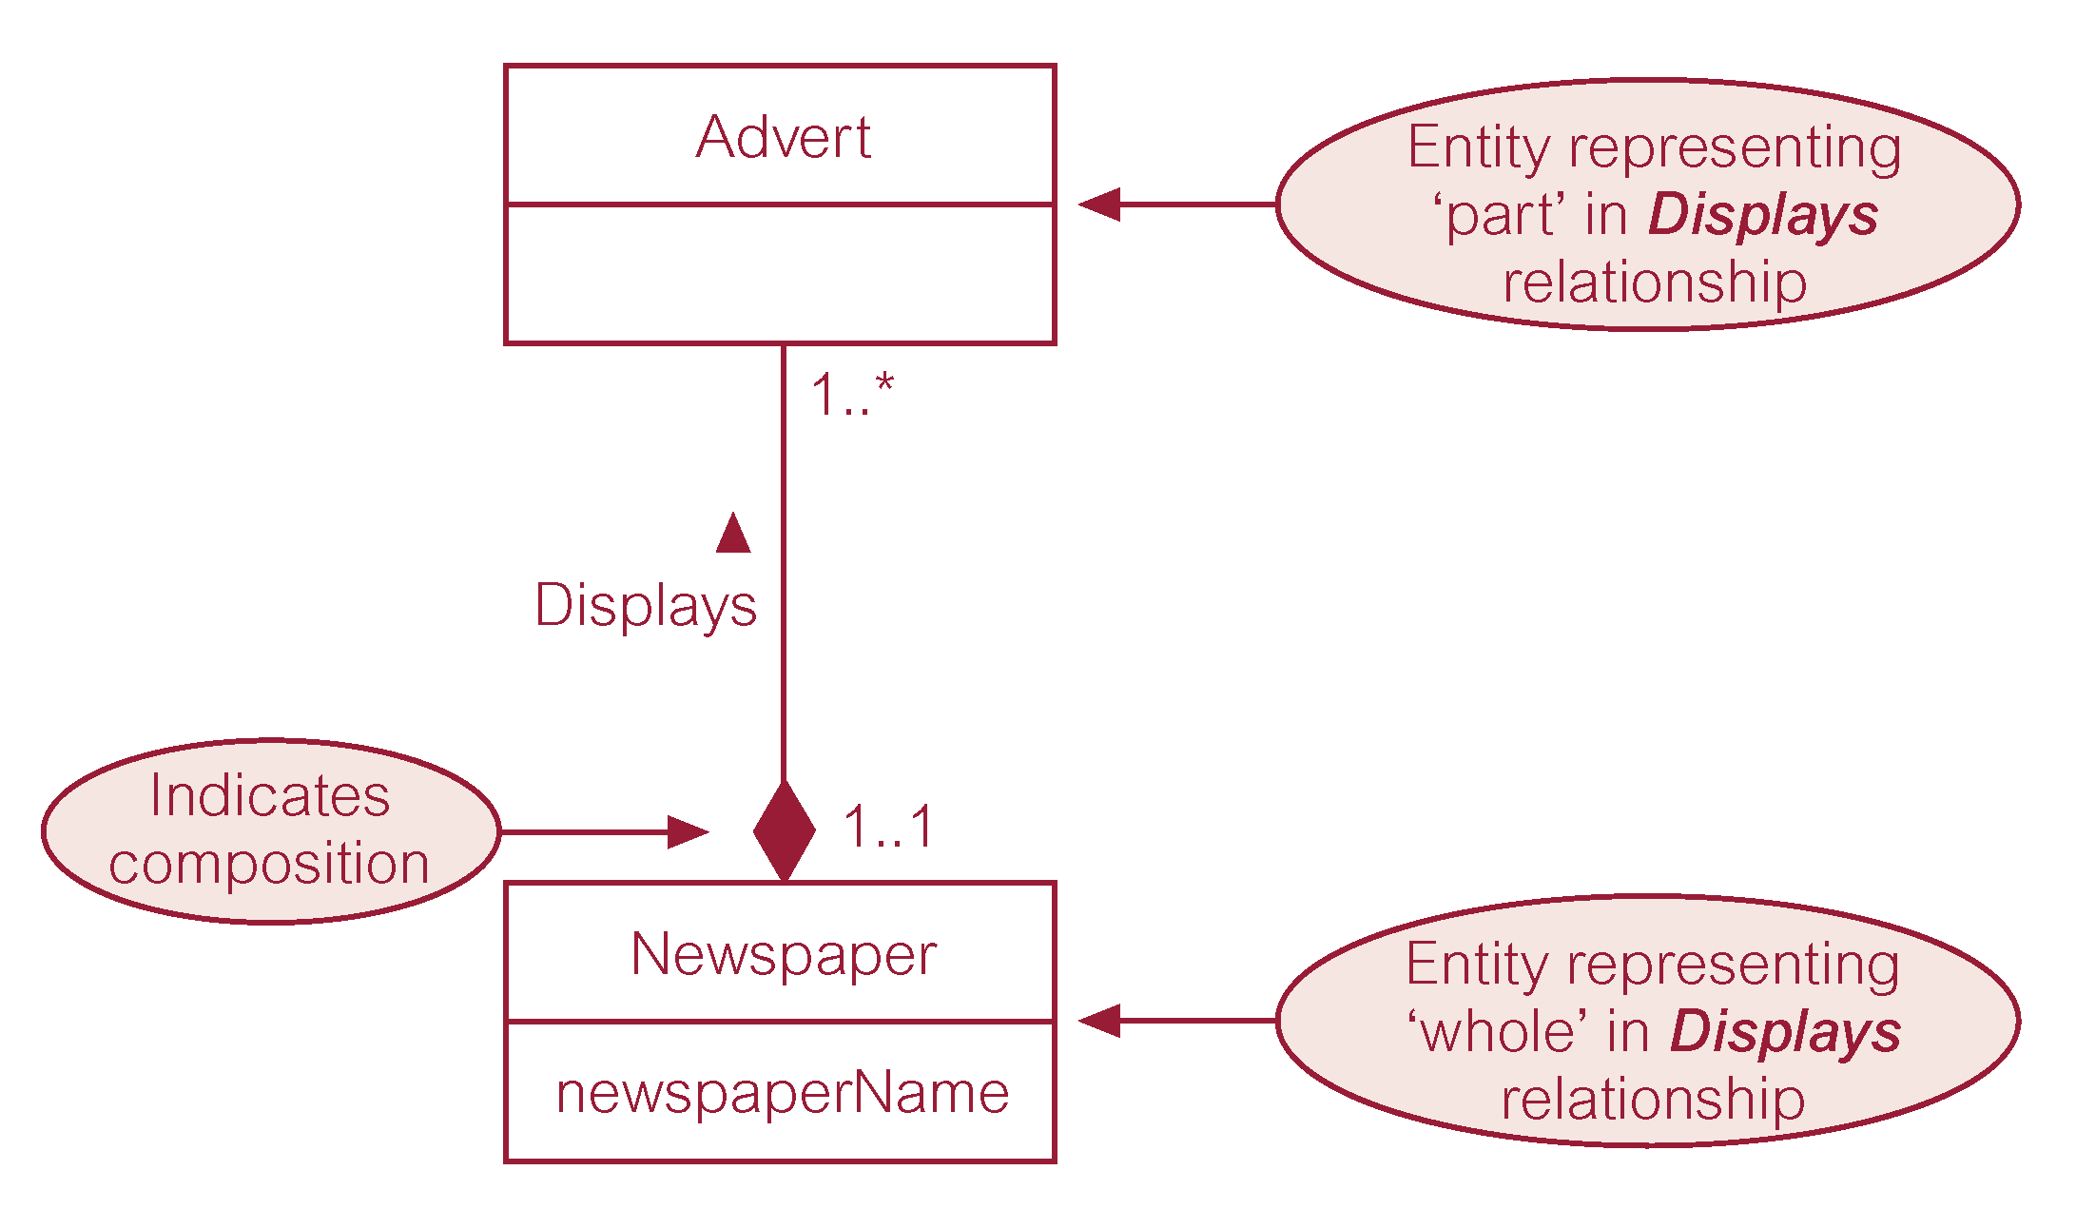
Example of Composition

